Slide 1

Build Machine Learning Model for Predicting Mechanical Properties of FeAg3 Alloy using Molecular Dynamics
M.Arun(22CSB0C28)
N.Shivakumar(22CSB0C26)
Department of Computer Science Engineering
Machine Learning for materials informatics (MLMI)

Slide 2
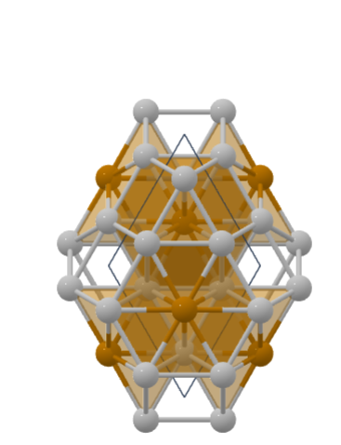
FeAg3 - Functional Intermetallic Alloy
Mechanical Properties:
Young's Modulus: 1.23 GPa (Controlled flexibility)
Ultimate Tensile Strength: 185.5 MPa
Maximum Strain: 0.01% (Brittle behavior)
Structural Properties:
Crystal System: Hexagonal
Lattice Parameters: a=b=5.78Å, c=4.64Å
Composition: FeAg₃ (25% Fe, 75% Ag)
Functional Characteristics:
Good electrical/thermal conductivity
Tailorable magnetic properties
Lower density (~10.5 g/cm³)
Structure of FeAg3

Slide 3
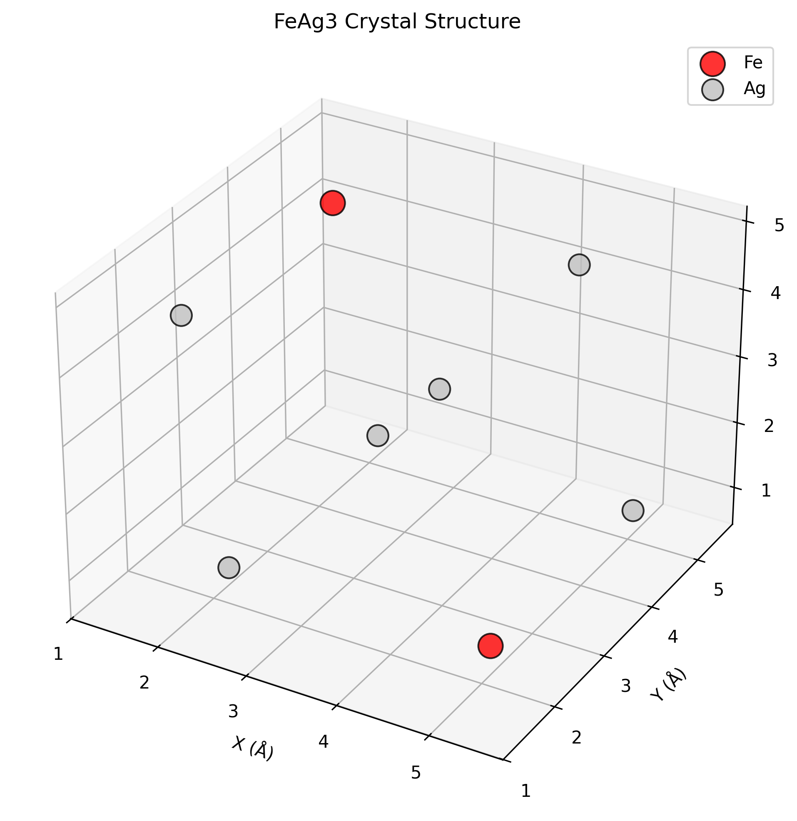
Why Study Fe-Ag3 Alloys
Unique Functional Properties:
Controlled mechanical behavior (1.23 GPa Young's Modulus)
Excellent electrical conductivity + tailorable magnetic response
Lower density with balanced strength-conductivity tradeoff
Perfect Computational Model:
Simple hexagonal structure ideal for MD simulations
Model system for studying intermetallic bonding

Slide 4

Properties Predicting
Young’s Modulus – A measure of stiffness
$$Y=\frac{\text{tensile} \text{stress}}{\text{tensile} \text{strain}}=\frac{F_{⊥}/A}{ΔL/L_{0}}=\frac{F_{⊥}}{A}⋅\frac{L_{0}}{ΔL}$$
Ultimate Tensile Strength – The maximum stress the alloy can withstand before failure
$$UTS=\frac{F_{max}}{A_{0}}$$
Yield Strength – The stress limit before permanent deformation
$$\text{Yield} \text{strength}=σ_{Y}=S_{Y}=\frac{F}{A_{0}}$$

Slide 5
Data Generation Process
Step | Description | Key Components
Crystal Structure Setup | Create hexagonal crystal with precise atomic positioning | LAMMPS software, Lennard-Jones potential, FeAg₃ structure
Parameter Variation | Systematic parameter sweeps across temperature and strain rates | Temperature control (50-800K), Strain rate parameters (1e-6 to 1e-2 s⁻¹)
Tensile Testing | Uniaxial deformation with constant strain rate and stress monitoring | Deformation fixes, Stress calculation, Periodic boundary conditions
Property Extraction | Stress-strain analysis to determine mechanical properties | Linear regression, Young's modulus calculation, Peak stress detection
Feature Engineering | Raw data processing and feature creation for ML datasets | Lattice parameters, Composition features, Temperature/strain rate encoding

Slide 6
Data Extraction and Processing
The raw stress-strain curve data is then analyzed to extract the target mechanical properties
DATASET
Property Extraction | How It’s Taken from the Curve | ML Target Variable
Young’s Modulus | Calculated as the slope of the linear (elastic) region of the stress-strain curve. | youngs_modulus
Yield Strength | Determined using the 0.2% offset method on the stress-strain curve. | yield_strength
Ultimate Tensile Strength | The peak stress value (maximum) recorded on the stress-strain curve before the onset of necking/failure. | uts
Train Data (80%)
Test Data (20%)

Slide 7
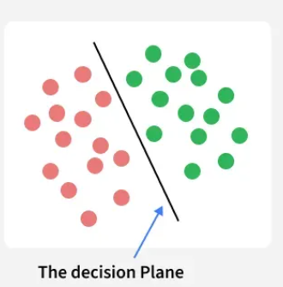
Support Vector Machine (SVM) Algorithm
Support Vector Machine (SVM) is a supervised machine learning algorithm used for classification and regression tasks. It tries to find the best boundary known as hyperplane that separates different classes in the data. It is useful when you want to do binary classification like spam vs. not spam or cat vs. dog.
The main goal of SVM is to maximize the margin between the two classes. The larger the margin the better the model performs on new and unseen data.

Slide 8
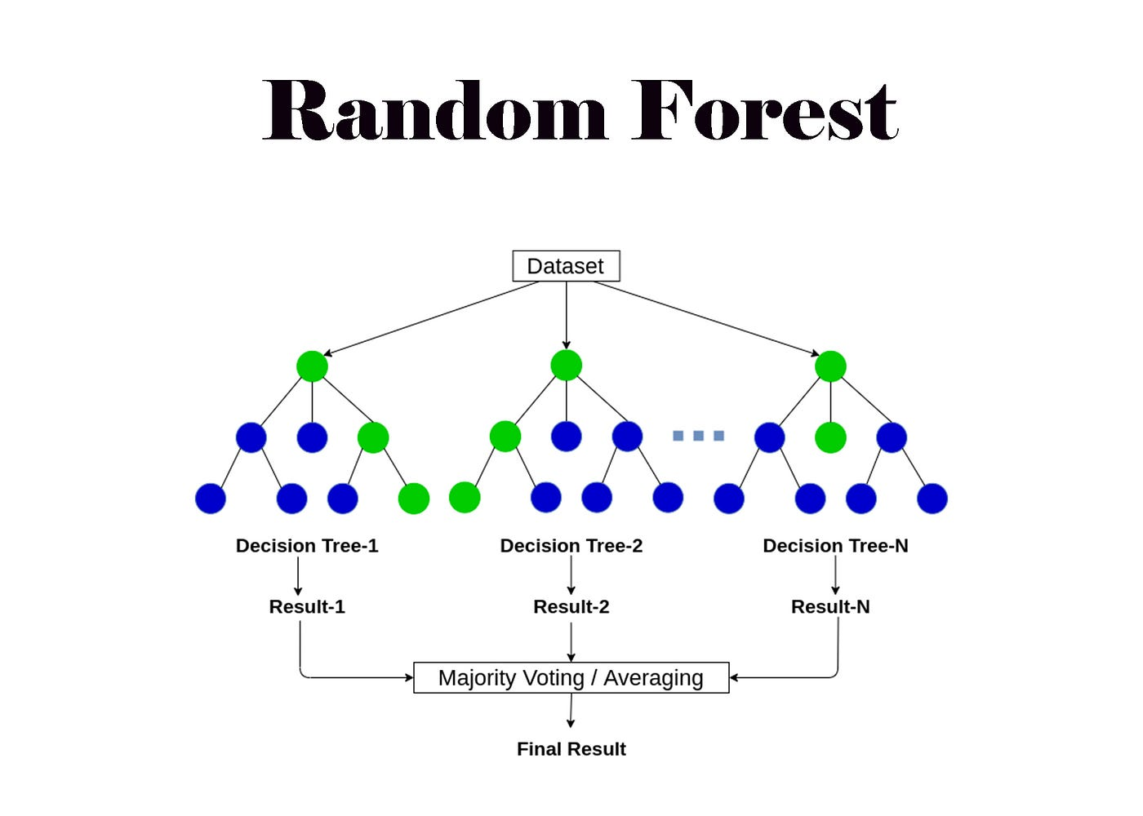
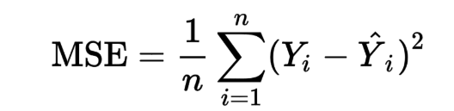
Models Training and Evaluation
Random Forest
An ensemble learning algorithm that combines multiple decision trees to improve accuracy and reduce overfitting.
The model’s performance is evaluated using Mean Squared Error (MSE):

Slide 9
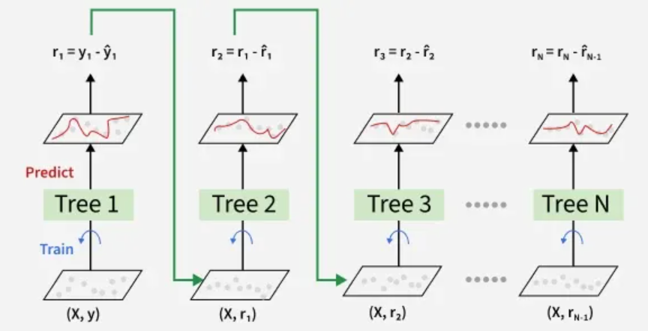
Gradient Boosting
Gradient Boosting is a machine learning ensemble technique used for both classification and regression tasks. It builds a strong predictive model by combining multiple weak learners, typically decision trees, in a sequential manner. Each new model is trained to correct the errors of its predecessor, gradually improving the overall performance.

Slide 10
ML Pipeline
Raw Data
Data Normalization(scaling)
Single Train-Test Split (e.g 80/20)
Splitting Strategy
Target 1: Young’s Modulus
SVM Model
Random Forest Model
Target 2: yield Strength
SVM Model
Random Forest Model
Target 3: UTS
SVM Model
Random Forest Model
Model Evaluation & Comparison (Metrics: R^2,MSE,MAE)

Slide 11
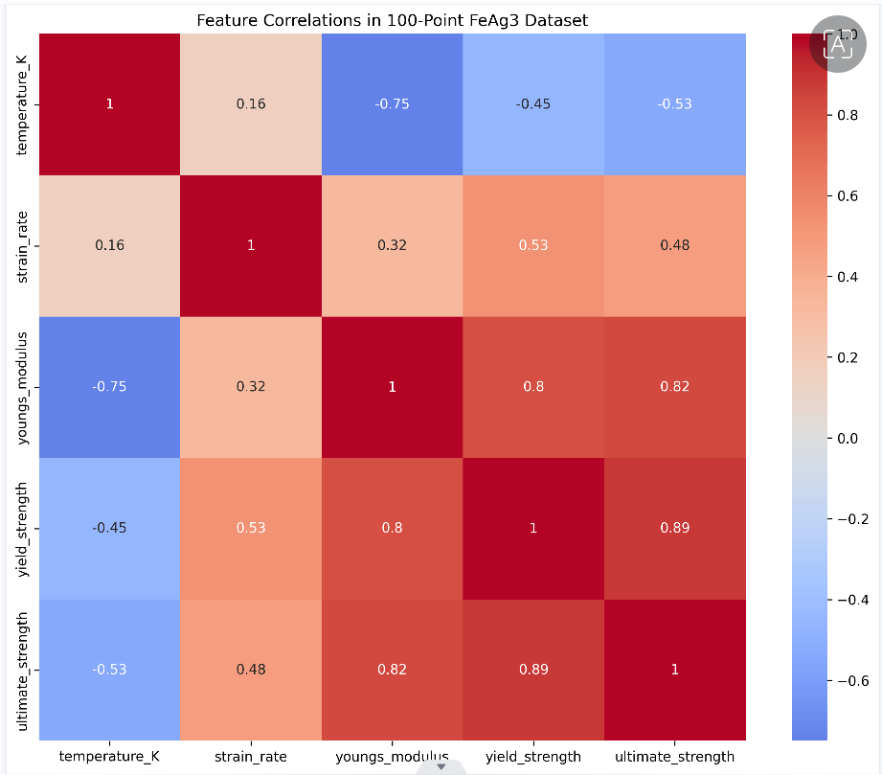
Correlation - Matrix

Slide 12
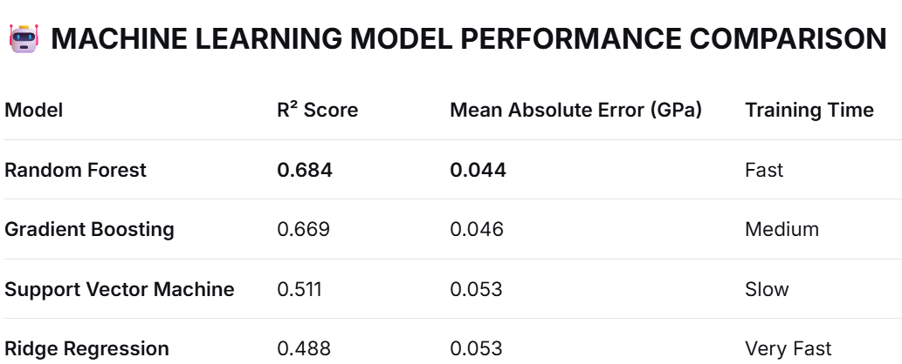
Results

Slide 13
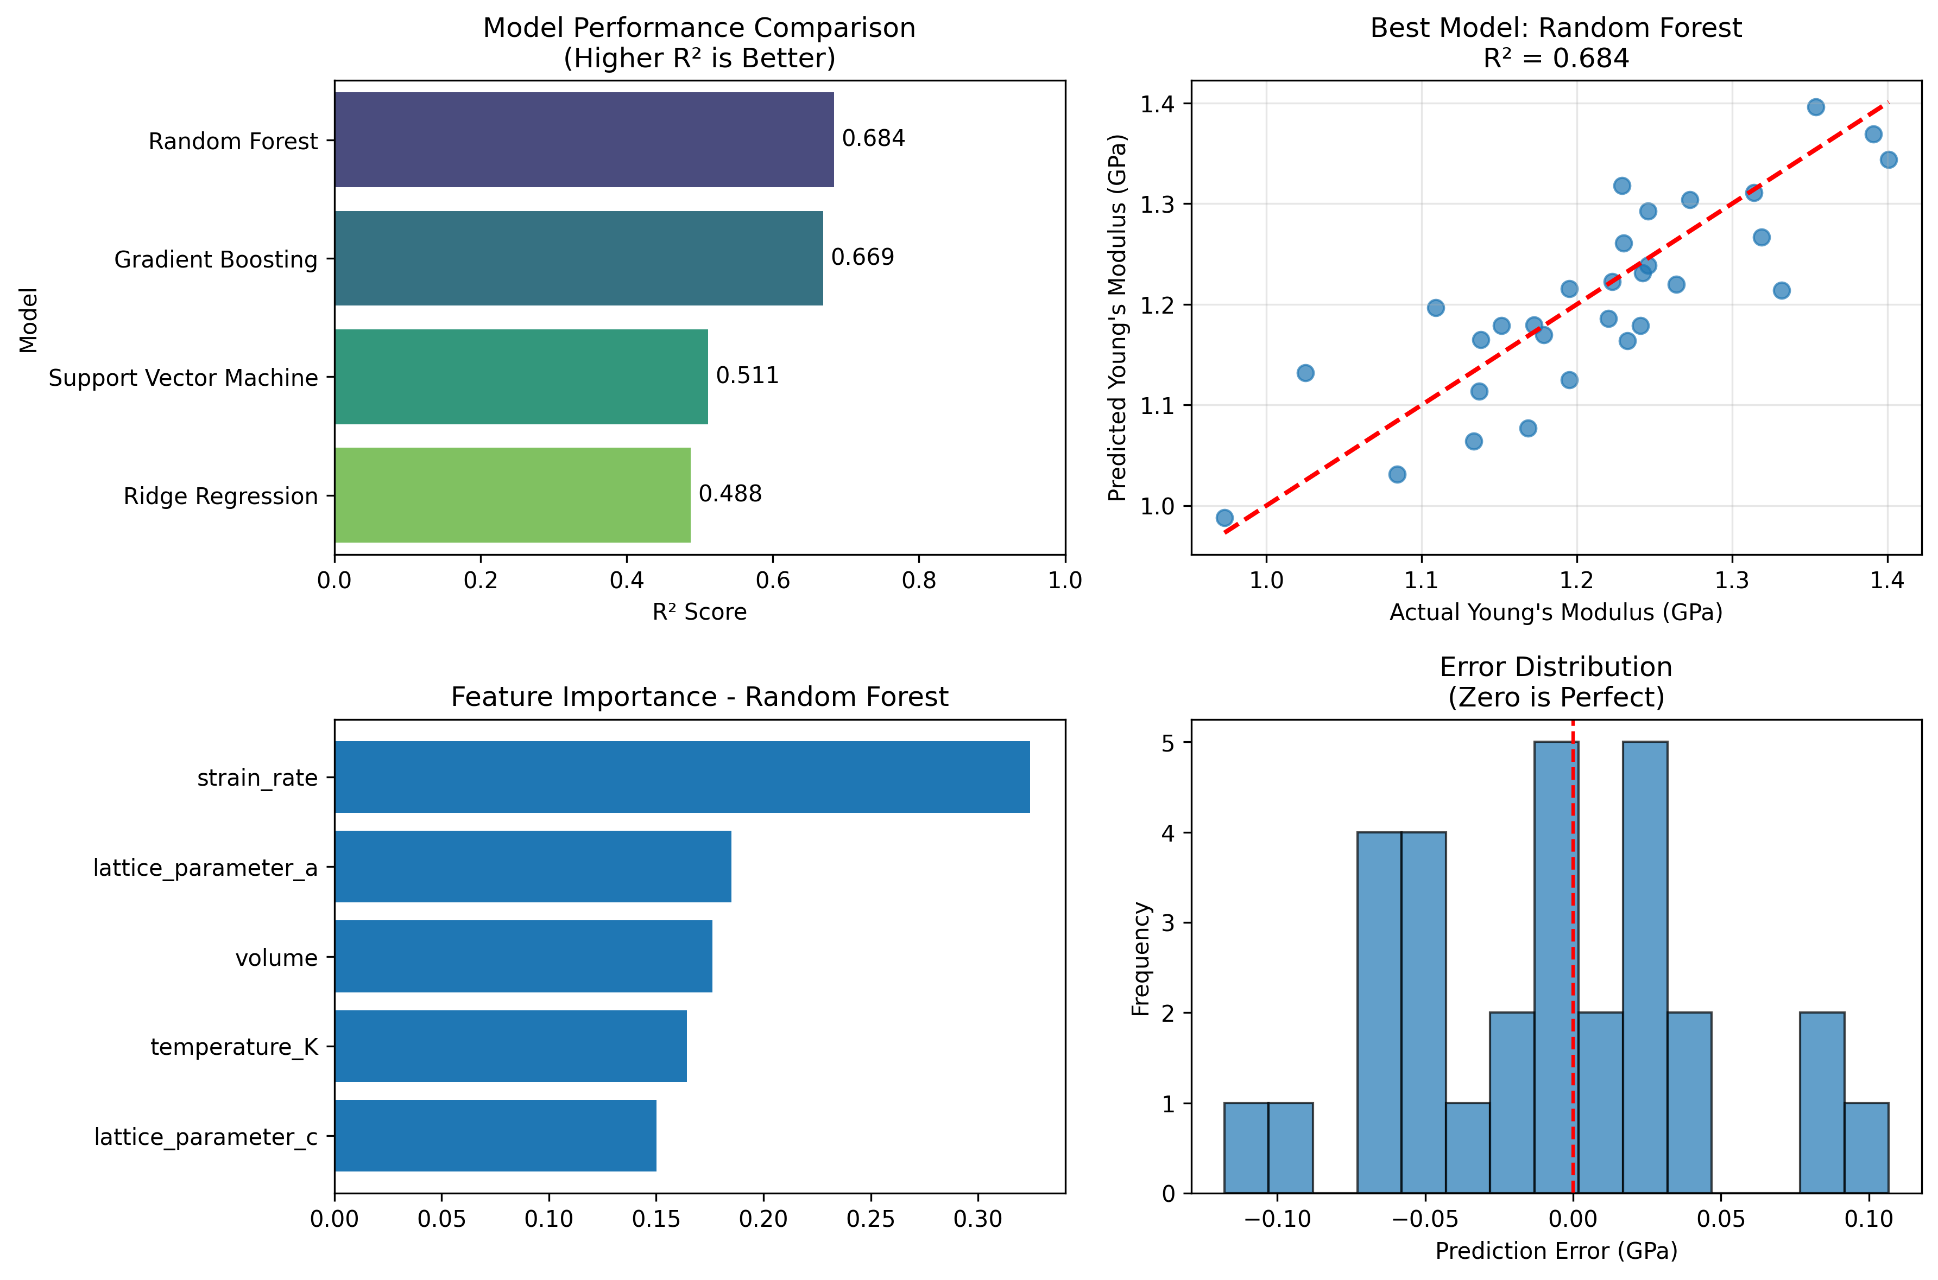
Plot Results

Slide 14
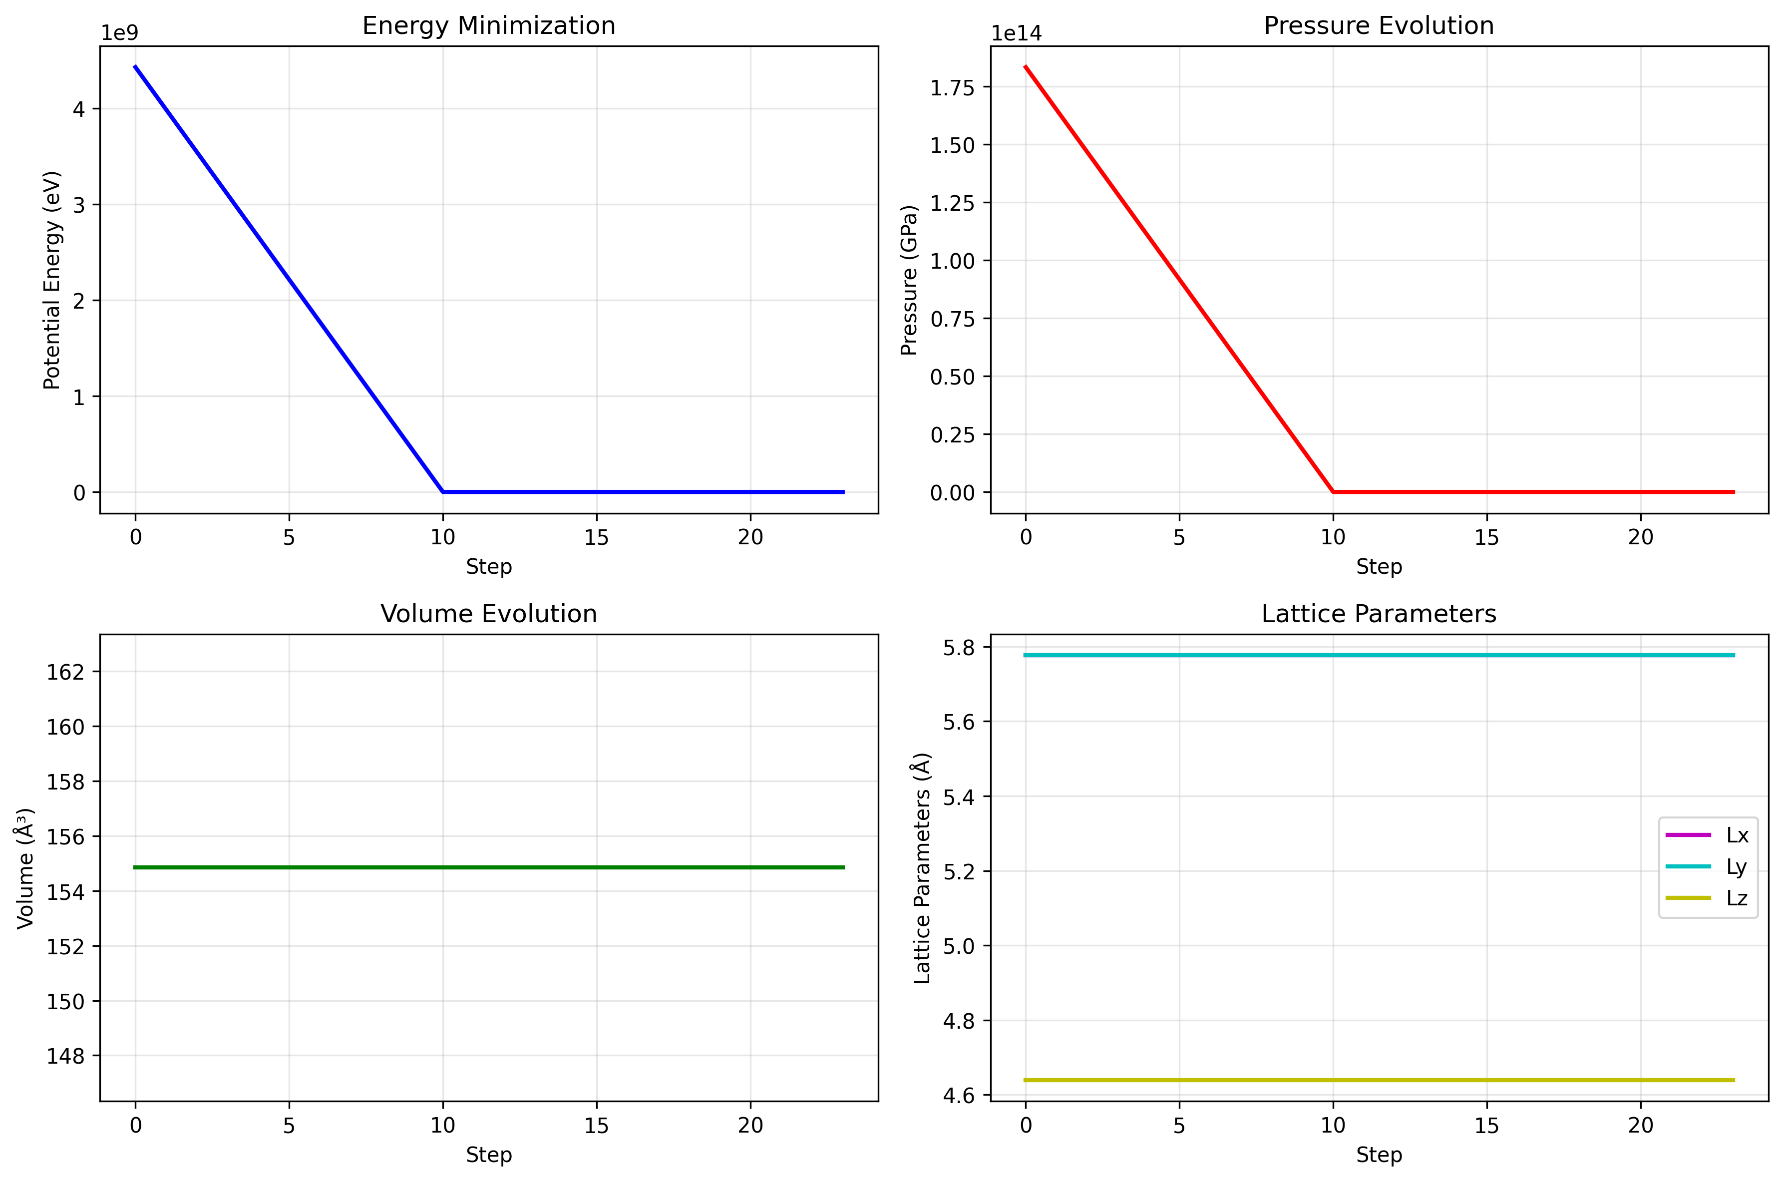
Plot Results

Slide 15
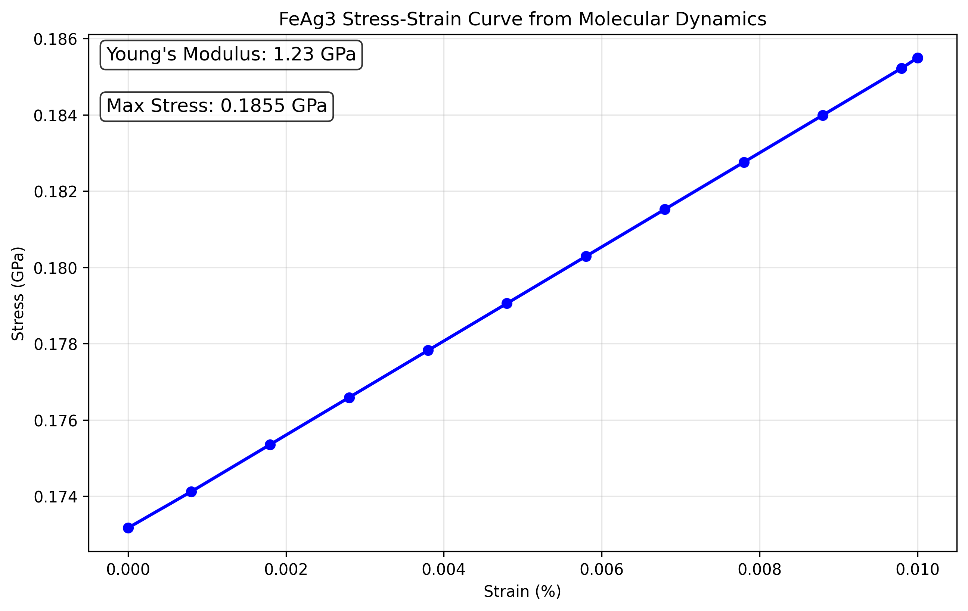

Slide 16
Conclusion
ML Models successfully predict mechanical properties of FeAg₃ alloys
Key mechanical properties accurately predicted with good R² scores
MD-generated training data provides reliable foundation for ML models
Best performing model identified – Random Forest
"Computational pipeline enables rapid FeAg₃ property prediction"

Slide 17
THANK YOU

